Slide 1

RANDOM COLOR
GENERATOR (WISHSAVER)
“Task-2”

Slide 2

RANDOM COLOR GENERATOR
▪The Random Color Generator is a fun and interactive project that allows you to
create a simple web application or program to generate random colors. This
project is a great way to learn about web development, user interfaces, and color
manipulation. It can be implemented as a standalone website, a mobile app, or
even integrated into other applications.
NM ID | NAME | BATCH
au820420205001 | Aadhavan.K | CF1
au820420205022 | HemaPriyah.P | CF1
au820420205023 | Hesham.A | CF1

Slide 3

Task - 2
Create UI and implement various components using react
Initialize React Project: Begin by setting up a React project using Create React App (CRA).
Build Components: Create components for generating colors, displaying them, and managing a wish list.
Manage State: Utilize React's state management to handle color generation and wish list updates.
Integrate the APIs to frontend to ensure the dynamic feature of website
Install MongoDB, create a database, and establish a collection to store data.
Create a backend API using Node.js and Express.js to handle saving and retrieving wishes in the MongoDB database.
Use fetch or a library like Axios to make API requests from your React frontend, enabling users to save and retrieve wishes from the MongoDB database
Evaluation Metric:
● 100% Completion of the above tasks
Learning Outcome
Gain proficiency in server setup, routing, and MongoDB database management.
Learn to interact between the React frontend and the backend API for dynamic data handling.
Understand the holistic process of developing a web application by coordinating frontend and backend components effectively.

Slide 4

Step-Wise Description
1.Project Planning and Design: Define the project's goals and objectives. Create a project plan, including timelines and milestones. Design the user interface (UI) for the Random Color Generator and Wish Saver features. Plan the database schema for storing wish list items in MongoDB.
2.Set Up Development Environment: Install MongoDB on your development machine. Choose a programming language (e.g., Node.js, Python) for the backend development. Set up a version control system (e.g., Git) for collaborative development. Create a new project directory for your application.
3.Backend Development: Develop the backend application to generate random colors and save wish list items. Implement the MongoDB connection and create the necessary collections and indexes. Create API endpoints for generating random colors and managing wish list items (CRUD operations).
4.Frontend Development: Develop the frontend user interface for the Random Color Generator and Wish Saver features. Integrate the frontend with the backend by making API requests for color generation and wish list management.
5.Testing and Quality Assurance: Write unit tests for the backend API endpoints. Test the application for functionality, including color generation and wish list management. Identify and fix any bugs or issues.

Slide 5
6. Documentation: Create comprehensive documentation for the project, including database schema, API endpoints, and usage instructions. Document the MongoDB data model for storing wish list items.
7. Deployment: Choose a hosting environment for your application (e.g., cloud hosting). Deploy the backend and frontend components. Configure environment variables and settings for production.
8.User Experience (UX) Enhancement: Apply UX design principles to improve the user interface's usability and aesthetics.
9.Scaling and Performance Optimization: Implement scaling strategies to handle increased user activity and data growth. Optimize database queries and indexing for improved performance.
10. Presentation and Communication: If required, present the project to peers, instructors, or stakeholders, showcasing the MongoDB integration and project achievements.
11. Maintenance and Updates: Maintain the application by addressing user feedback and making necessary updates. Keep the MongoDB database up-to-date and ensure data integrity.

Slide 6
Summary of the task
The "Random Color Generator Wish Saver" project, powered by MongoDB, is a web application offering users two core functionalities. Firstly, it generates random colors dynamically and provides a platform for users to save their favorite colors.
It serves as a wish list manager, enabling users to create, modify, and delete items on their wish lists, with MongoDB handling the efficient storage and retrieval of wish lists data.
User authentication, if implemented, ensures security and personalization. After deployment, ongoing maintenance guarantees the application's continued functionality, making it a user-friendly and interactive platform for color enthusiasts.

Slide 7
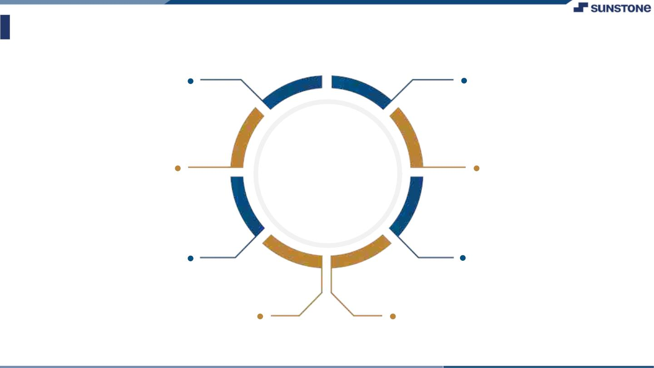
Assessment Parameter
Gather requirements for the
project
Add Readme.md file with description of the project
Prepare database design
schemas
Check-List
Commit all changes with "first commit"
Get your initial project
Structure ready
Create a repository on github realted to project
Initiate a
Initiate a git repository
Push your changes to github

Slide 8

Submission Github
https://github.com/HemaPriyah1/Hema1103

Slide 9


